Slide 1
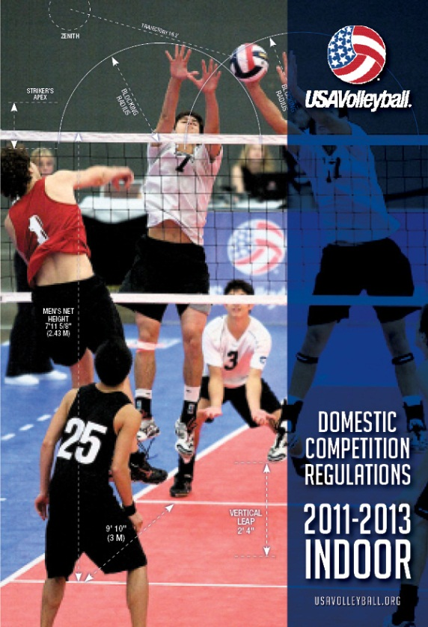
DCR Significant Changes 2011-2013
http://usavolleyball.org/resources/officials-rules/domestic-competition-regulations
Notes:
This season is a new year for the DCR, and hopefully, you have all received one from your region or will receive it soon. You can also find the DCR on the USAV web site at the URL seen on this slide. It is always a good idea to carry a copy of the most recent DCR with you to every match.
Let’s take a look at what is new in the DCR for the next two seasons!

Slide 2
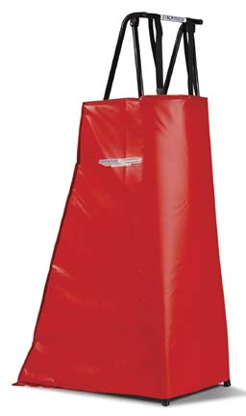
Referee Stand
USAV 2.6d – Basic equipment includes a referee stand, which should be adjustable to allow the referee’s eye position to be approximately 50cm (19”) above the top of the net. It should be constructed so that it presents the least potential hazard for participants.
If an appropriate referee stand cannot be provided, the first referee performs his/her functions from the floor.
The front and sides of the referee’s stand must be padded
Notes:
Although it was in the last DCR, referee stands are still a point of emphasis for the new DCR.
Basic equipment for a match includes a referee stand, which should be adjustable to allow the referee’s eye position to be approximately 50 cm (19”) above the top of the net. The stand should be constructed so that it presents the least potential hazard for participants. Step ladders, jump boxes and other devices not specifically designed as referee stands shall not be used. If an appropriate referee stand cannot be provided, the first referee performs his/her functions from the floor.
The front and sides of the referee’s stand must be padded in the same manner as the posts, to a height of 1.7 m (5’6”).
If you go to VRT, you will find an excellent module on USAV Referee Platform Requirements. It would be beneficial to you if you read it over before your first tournament this season!

Slide 3
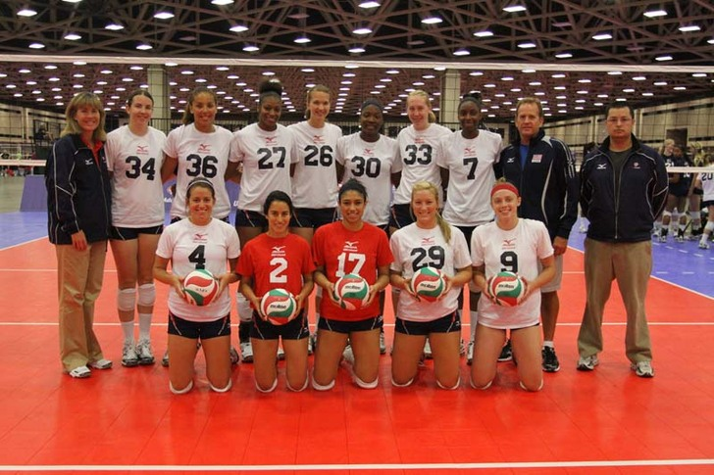
Two Liberos
What?
Two Liberos?
Yes, the teams are allowed to designate two Liberos for the match
Notes:
Beginning this season, teams will be able to designate two Liberos for each match.
The Libero players must wear a uniform (or jacket/bib for the re-designated Libero) whose jerseys at least must contrast in color with that of the other members of the team. The Libero uniform may have a different design, but it must be numbered like the rest of the team members.
The Libero player’s jersey must contrast in color with that of the predominant colors of the jerseys of the other team members. If a team is using two Liberos, it is not necessary for the Libero jerseys to be identical. It is only necessary for both jerseys to contrast with the other team members jerseys. And remember that in USAV rules, it is not necessary for the Libero to wear the same shorts as other players.
As noted earlier, color combinations such as purple/black, dark green/black, navy/maroon, and white/light yellow are not distinctive enough to comply with the rules.

Slide 4

Designation of the Libero
Each team has the right to designate up to two (2) specialized defensive players: Liberos
One Libero, designated by the coach or captain before the start of the match, will be the starting Libero. The Libero on court is the Acting Libero. If there is a second Libero, he/she will act as the second Libero.
Only one Libero may be on court at any time.
Replacements involving the Libero are not counted as substitutions.
Notes:
Rule 19.1.3 reads: One Libero designated by the coach before the start of the match will be the starting Libero. The Libero on court is the Acting Libero. If there is another Libero, he/she will act as the second Libero.
And Rule 19.1.4 states: Only one Libero may be on court at any time.
Remember that the team can choose to designate one or two Liberos for the MATCH, but if they choose to designate only one, that Libero will be used for the entire match; the team can not re-designate a Libero for each set. Also, when a player is designated as one of the Liberos for the match, they cannot play as a regular player, except as the rules apply for exceptional substitutions.

Slide 5
Designation of the Libero
Replacements are unlimited, but there must be a completed rally between two replacements involving a Libero (unless a penalty causes a rotation to position 4, or the Acting Libero becomes unable to play, making the rally incomplete).
The Acting Libero can only be replaced by the regular replacement player for that position, or by the second Libero. The regular replacement player may replace either Libero.
The coach has the right to replace the Acting Libero with the second Libero for any reason after a completed rally at any time during the match.
Notes:
Rule 19.3.2.2 states: The Acting Libero can only be replaced by the regular replacement player for that position, or by the second Libero. The regular replacement player may replace either Libero. The coach has the right to replace the Acting Libero with the second Libero for any reason after a completed rally at any time during the match.
You will learn all the nuances of this rule as the season progresses, but some of the things you need to remember are these:
The starting Libero must be the first one in the match IF a Libero is used the first rally of the match. If a Libero is not used on the first play of the match, then either Libero may enter the match after the first play
Only one Libero at a time may be on the court
A completed rally must occur before a Libero exchange can occur – unless there is a forced rotation due to a penalty or there is an injury to a back row player or the Acting Libero on the play

Slide 6
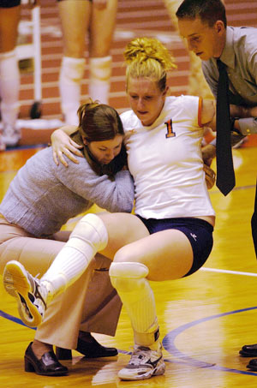
Re-Designation of a New Libero
Injury
Illness
Notes:
When a team uses two Liberos but one becomes unable to play through injury or illness, the team has the right to play with only one Libero and the second Libero becomes the Acting Libero.
No re-designation will be allowed, however, unless the Acting Libero is unable to play for the match and the remaining Libero has also been declared unable to continue.
At that point, the coach or captain may choose to re-designate one Libero, but NEITHER of the original Liberos will be allowed to play the remainder of the match.

Slide 7
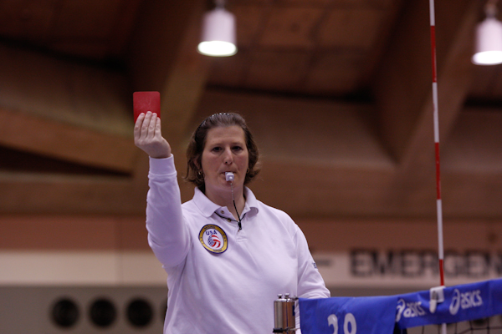
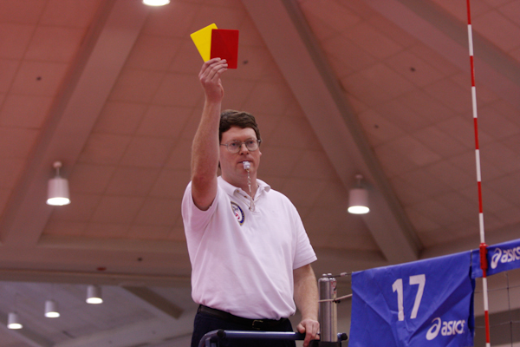
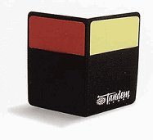
Expulsion or Disqualification of Libero
Expulsion (Red Card)
First offensive conduct or second rude conduct
Player/sub must remain on bench and may not play for remainder of set
Other expelled member must leave playing area, bench, warm-up area for remainder of set
No further penalty
Disqualification (Red & Yellow Cards)
  First physical attack or implied aggression, second offensive conduct, third rude conduct
  Must leave playing area, warm-up area and spectator area for rest of match
  No further penalty
Notes:
If a Libero is expelled he/she may be replaced directly by the team’s other Libero or by the player the Libero replaced. If the second Libero becomes injured during that set, no re-designation may occur. The expelled Libero may return in the next set.
If a Libero is disqualified, he/she may be replaced directly by the team’s other Libero or by the player the Libero replaced. If the second Libero becomes injured during play, the team may re-designate another Libero and both the injured Libero and disqualified Libero will not be able to play the remainder of the match.
If a team has designated only one Libero for the match, and that Libero becomes injured and is unable to play, the team may then designate another Libero and the injured Libero may not play for the remainder of the match.

Slide 8
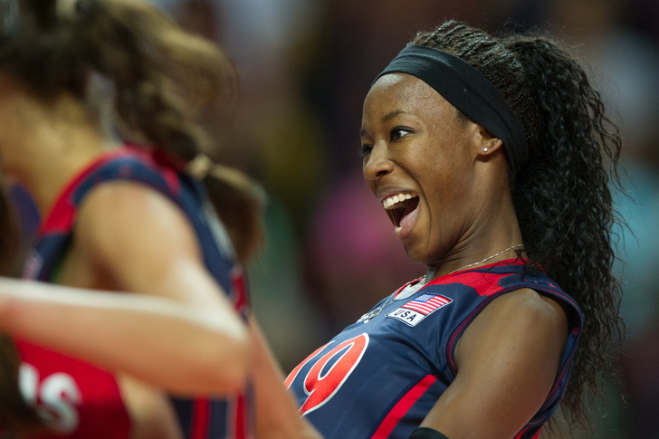
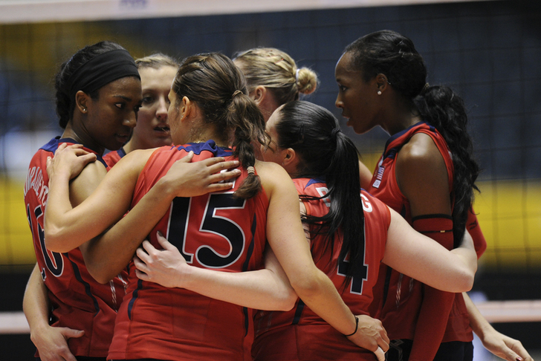
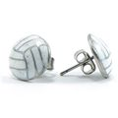
Jewelry – Adults Only
Jewelry is NOT allowed in Junior play
Jewelry is allowed in ADULT play
Notes:
USAV Rule 4.5.1 states: It is forbidden to wear hats or casts (even if padded).
Braces, jewelry, prosthetic limbs or other headgear that may cause an injury or give an artificial advantage to the player must not be worn.
If a brace, prosthetic limb or headgear is used, padding or covering may be necessary.
A Junior volleyball athlete participating in a Junior event may not wear jewelry. An exception will be made for religious or medical medallions that are removed from chains and taped or sewn under the uniform.
For adult play only, USAV will be using the rule as written by FIVB. Jewelry will be allowed during play, but jewelry that is deemed unsafe by the referees must be removed. If you see necklaces that are long and dangly, or have heavy pendants on them; or if a player has a multitude of bracelets on the arms, or is wearing hoop earrings, you should have the player remove the unsafe jewelry. It will be your discretion what is unsafe for a player to wear during play.

